Slide 1

Voice Assistant Examination System using Android
Done By
191FA04380
191FA04025
191FA04057
191FA05254
191FA05242
Guide:
B.Jyostna Devi(CSE)
M.Kiranmai(ECE)

Slide 2
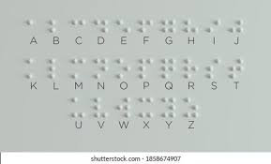
Introduction(Problem Statement)
Braille is a technique used by blind people to read/write. The main
Disadvantage of this technique is it’s very time consuming processing and it take more space to write the content i.e more paper
Will be wasted. In order to avoid wastage of paper another people need to attend the exam with the person so that the person write what the blind person dictate. But the main problem arise is the people are busy with their life. They may come or may not ultimately the blind person loss the exam. In order to avoid this problem we introduced a voice assistant examination system using android. The blind person able to listen the question and able to answer through voice.

Slide 3
Requirements
Software:
Visual Studio code
Android Studio
Firebase
Languages:
Html ,Javascript,Css,Bootstrap
Java
xml

Slide 4
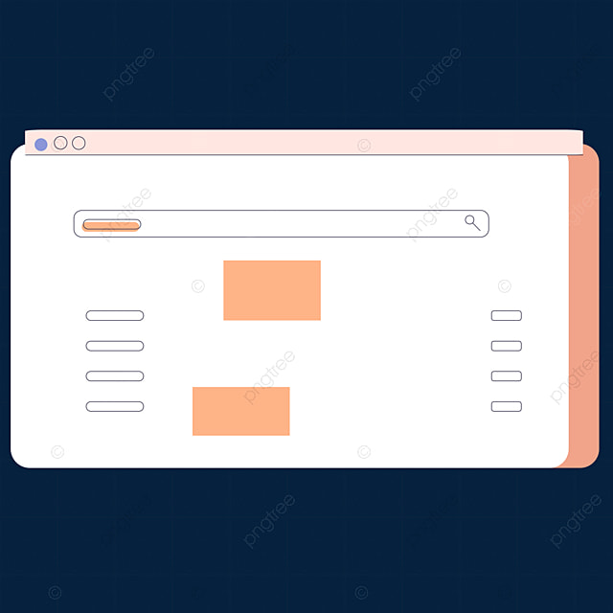


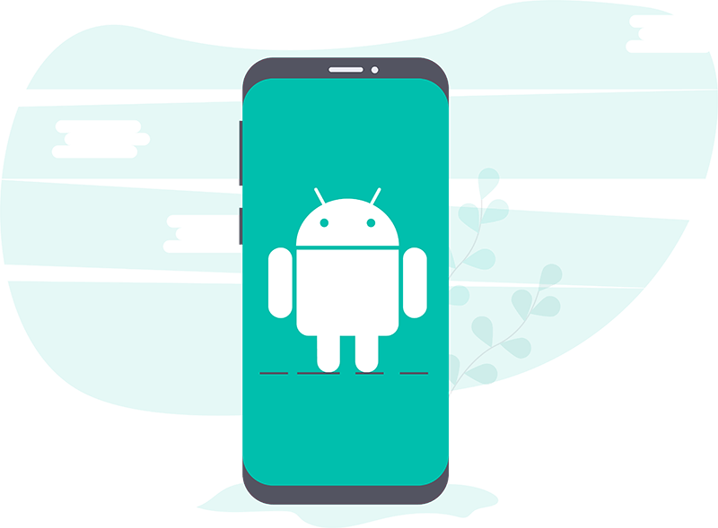

Working of the project
Website
Teacher
Blind Person
Android

Slide 5
The teacher use the Website for
Registration
Make the question paper
Schedule the Exam
Evaluate the Exam
Seeing the Result
Statistics
Answers
messaging

Slide 6
The Android is having the exam tab to write the exam and the message to
Message the admin if having any doubts.
The app can be used both by blind people and normal people. Normal people have the interface with touching whereas for blind people the touch will be disable and the blind person interact with the app through voice .They just need to take another person help in order to login through the app.Later the app take care with the help of voice assistant.
Firebase:
The complete data of question,results, userdetails will be store in the
Firebase database.
Hosting also done through the firebase.as it is available for free of cost.

Slide 7
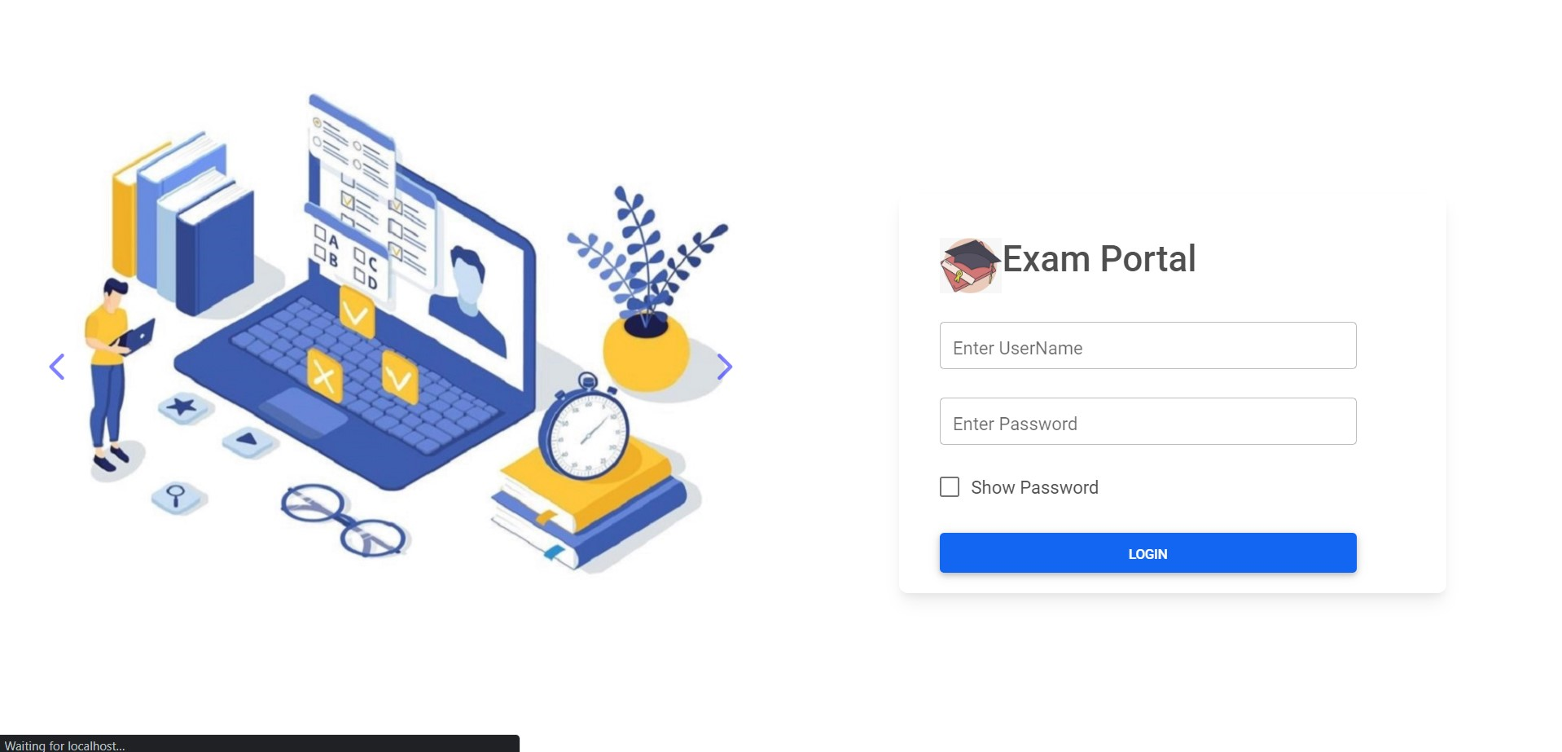

Slide 8
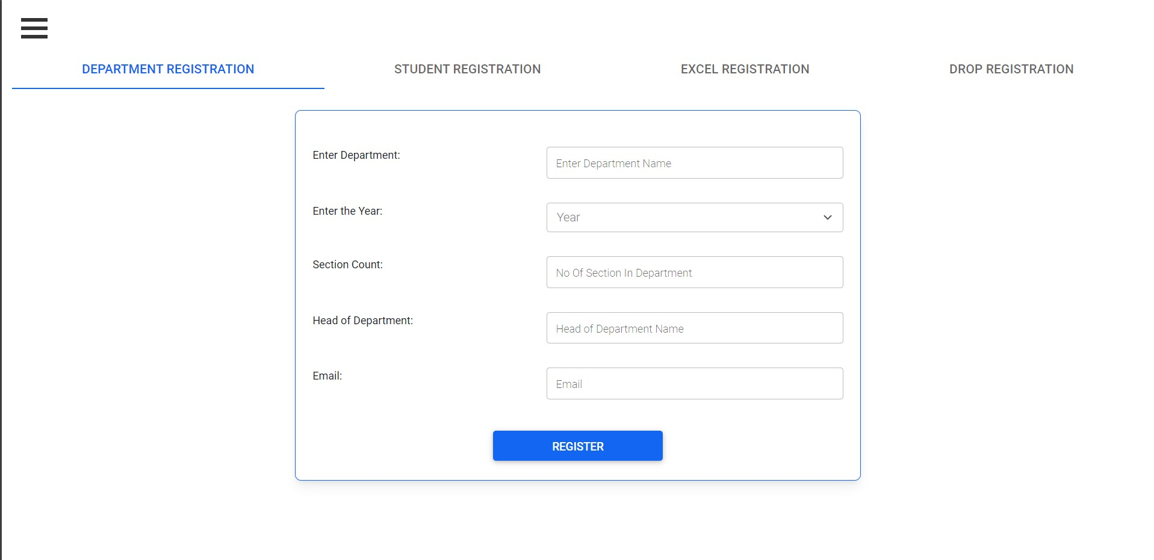

Slide 9
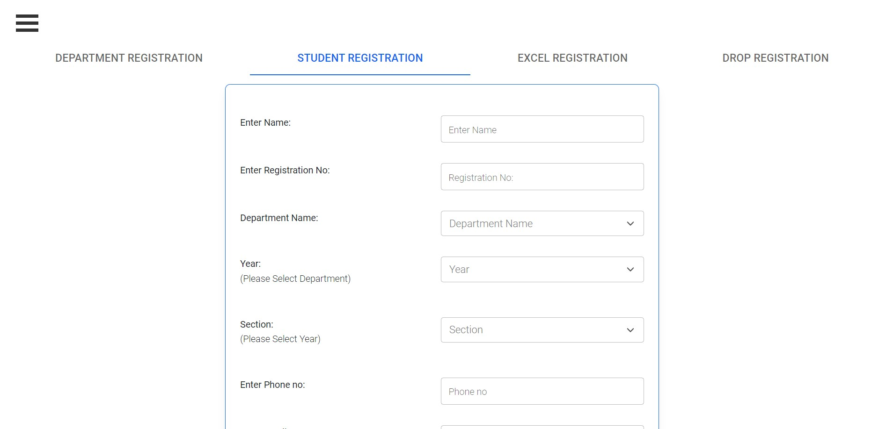

Slide 10
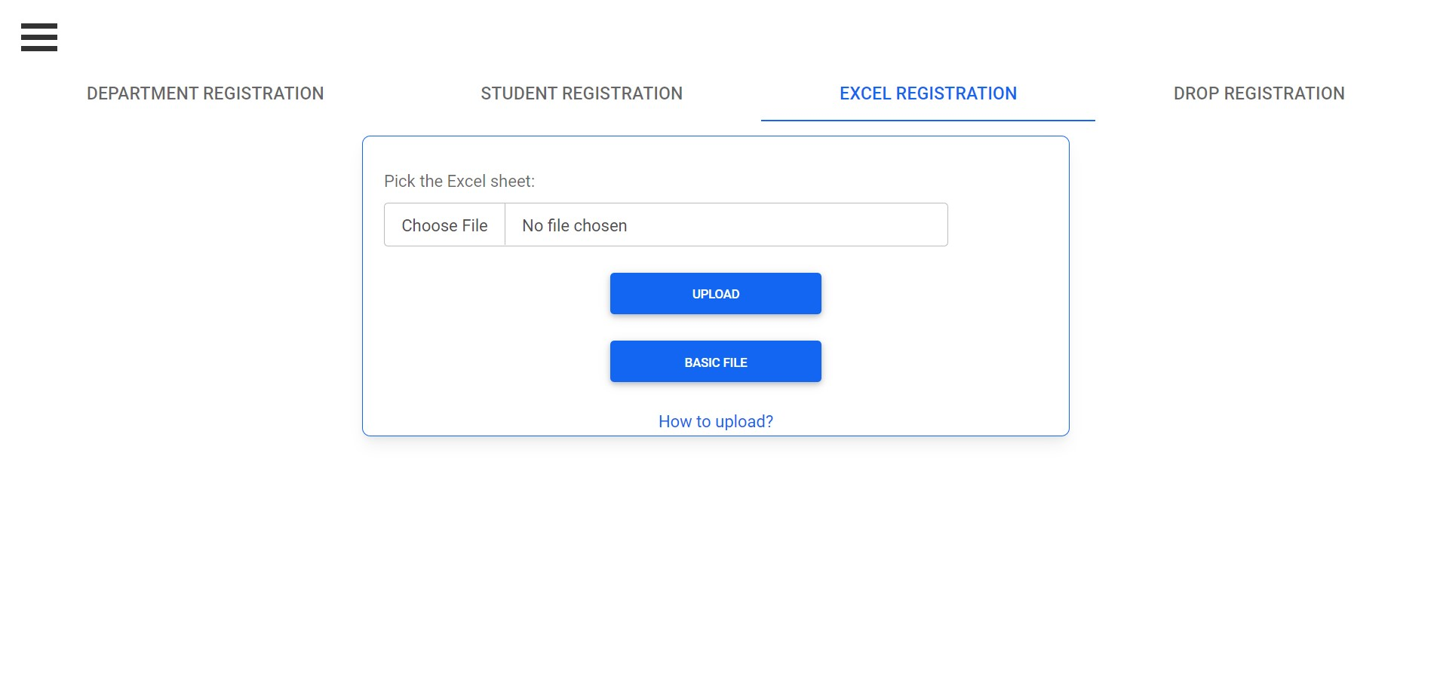

Slide 11
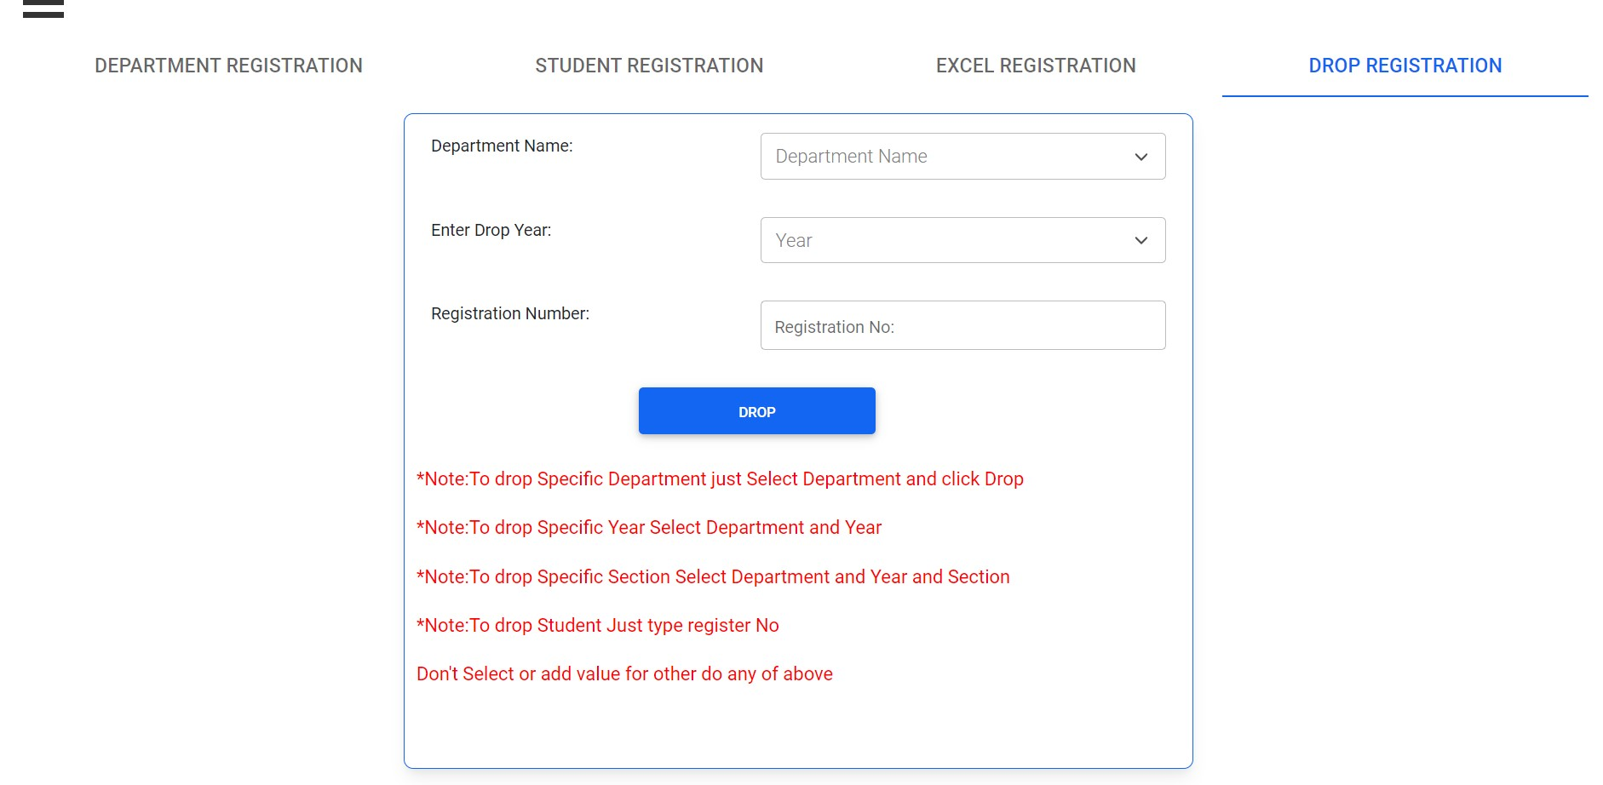

Slide 12
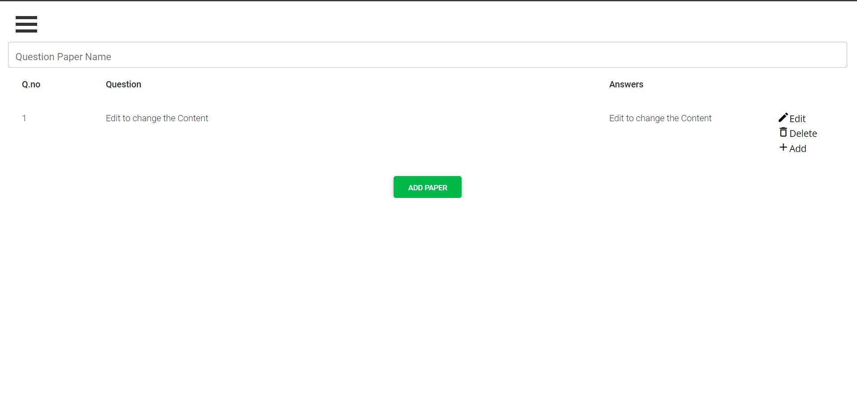

Slide 13
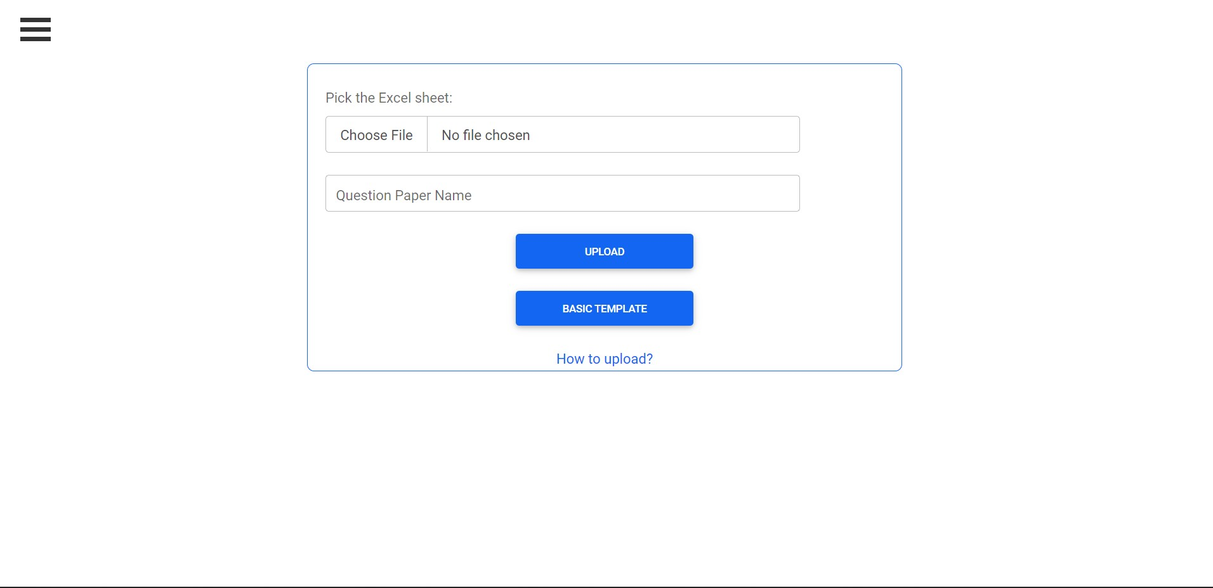

Slide 14
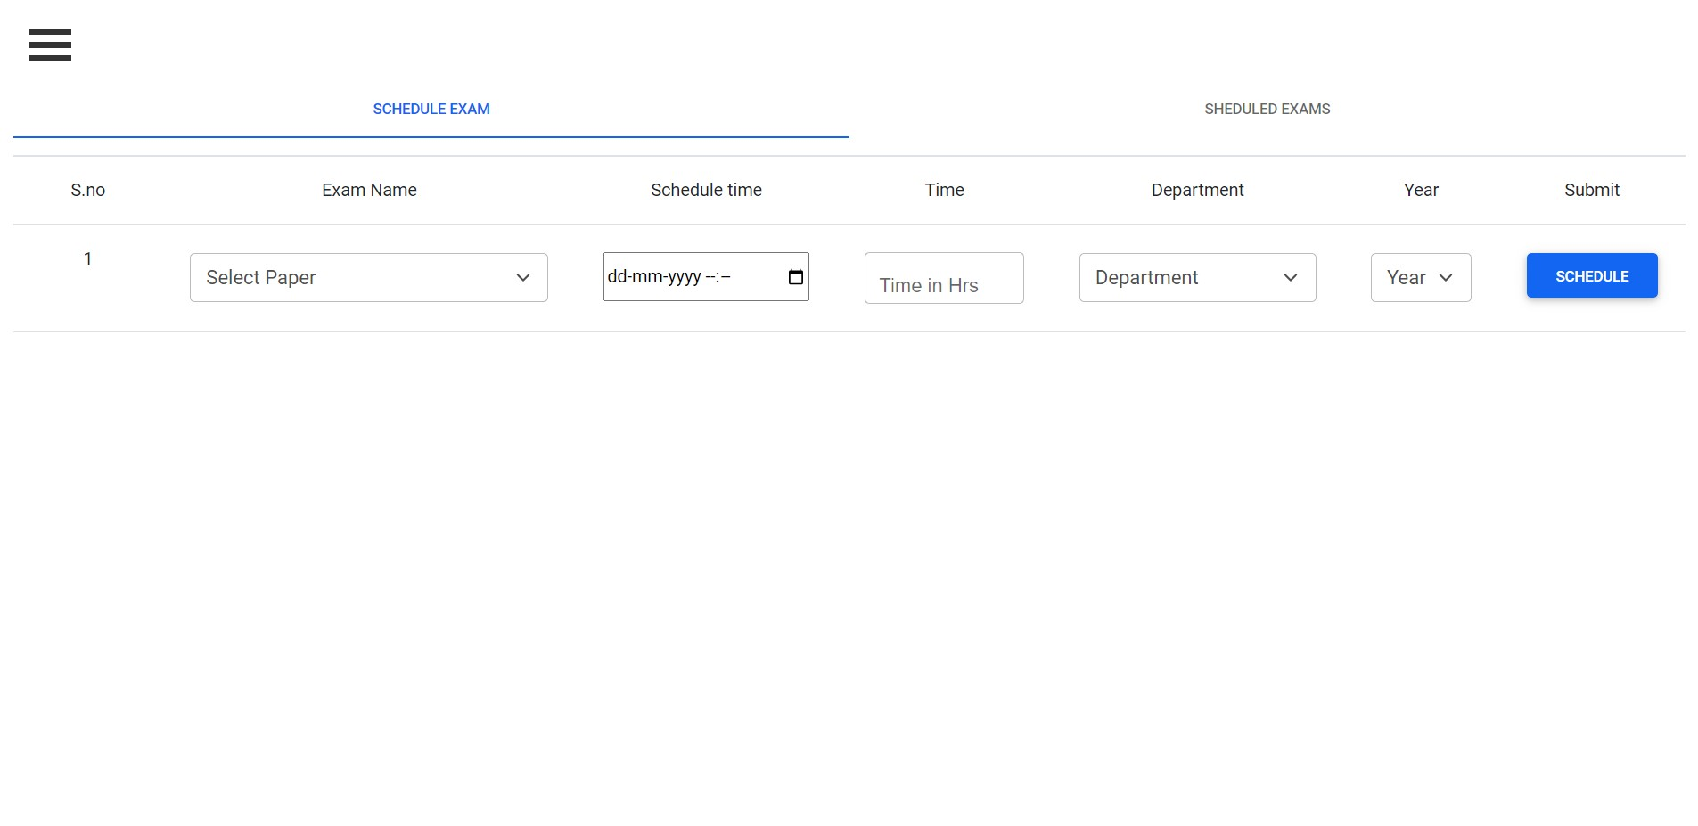

Slide 15
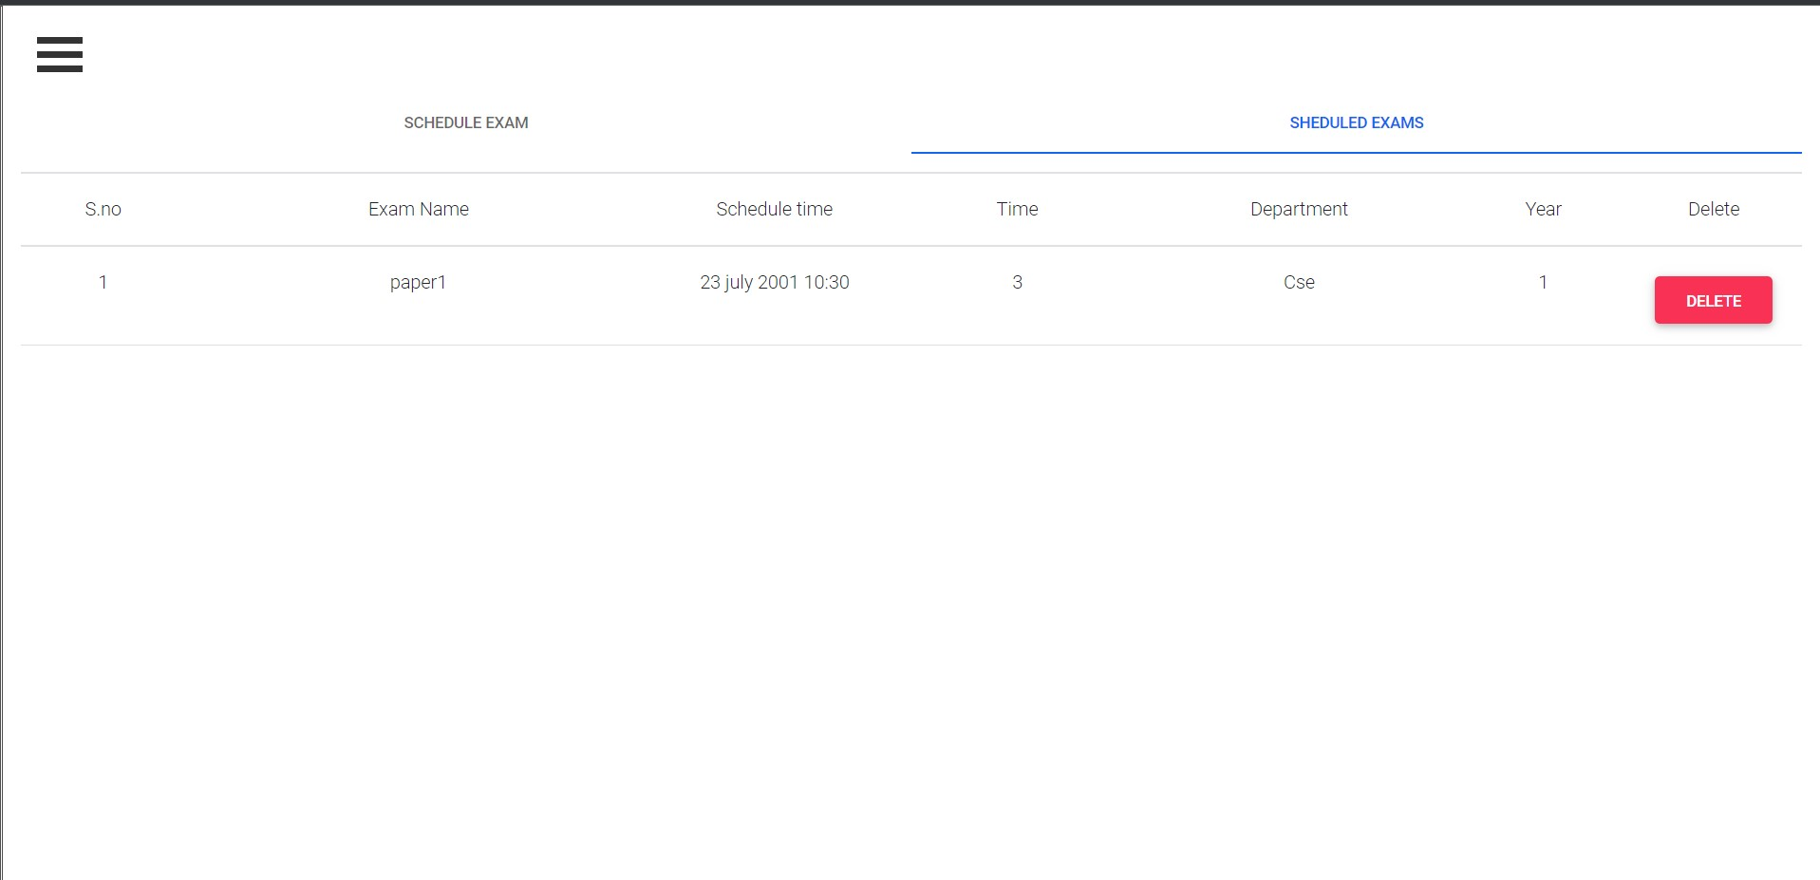

Slide 16
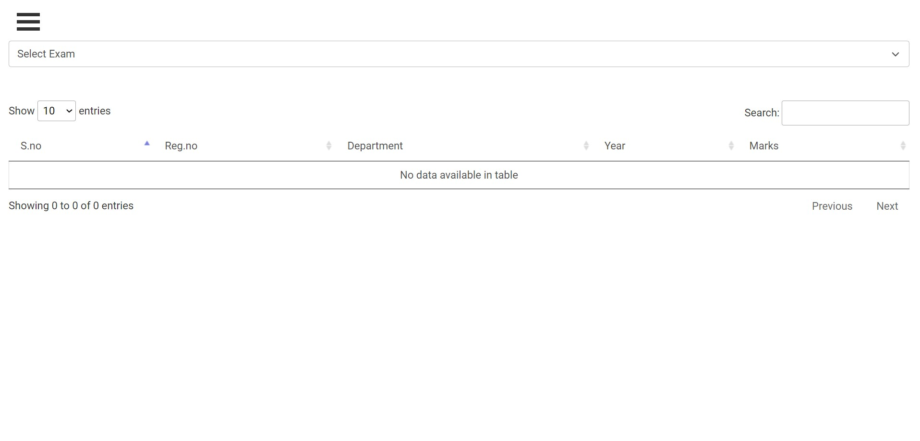

Slide 17
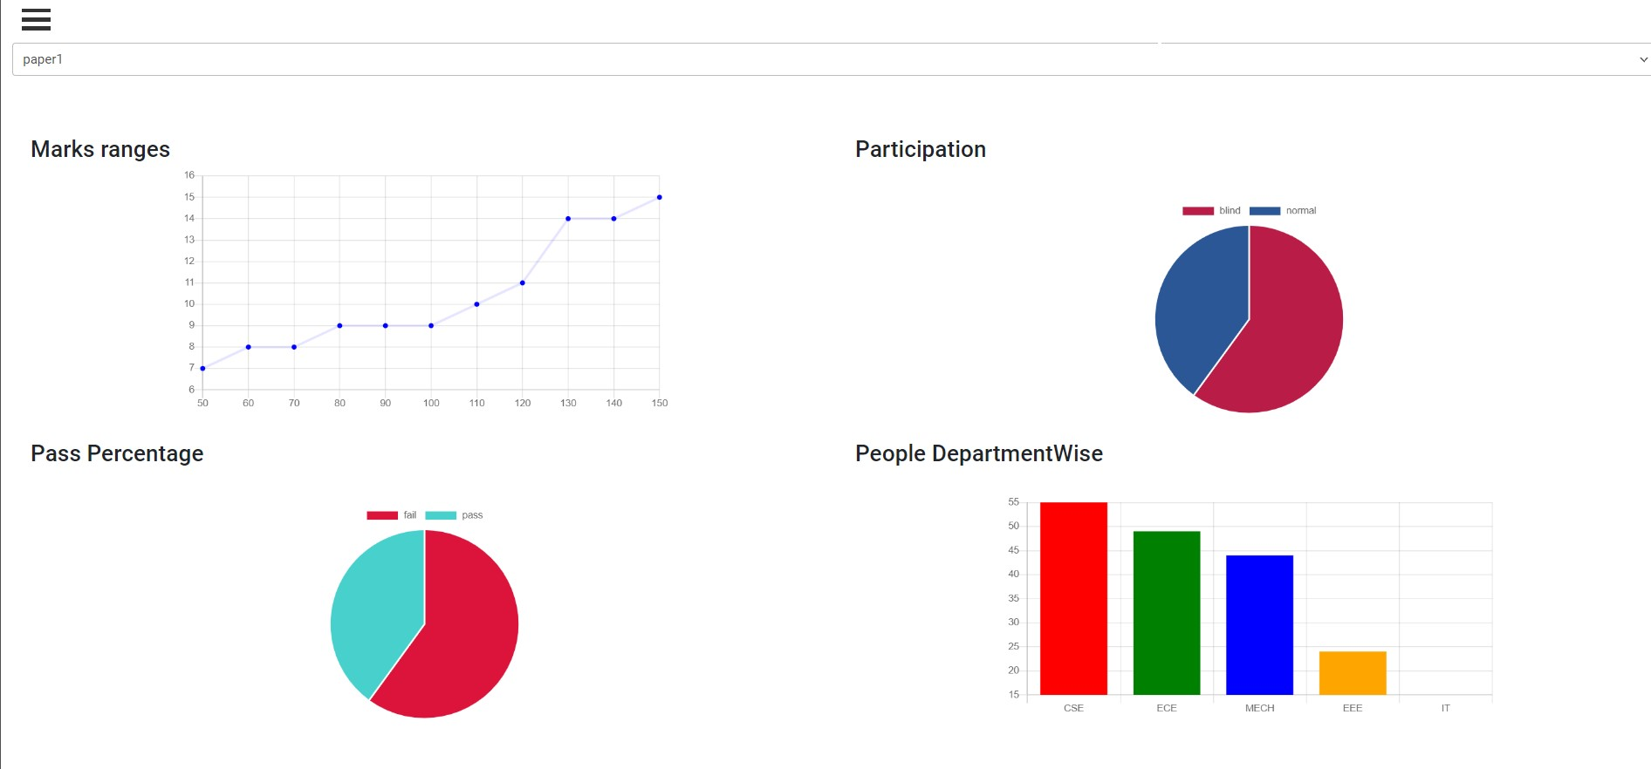

Slide 18
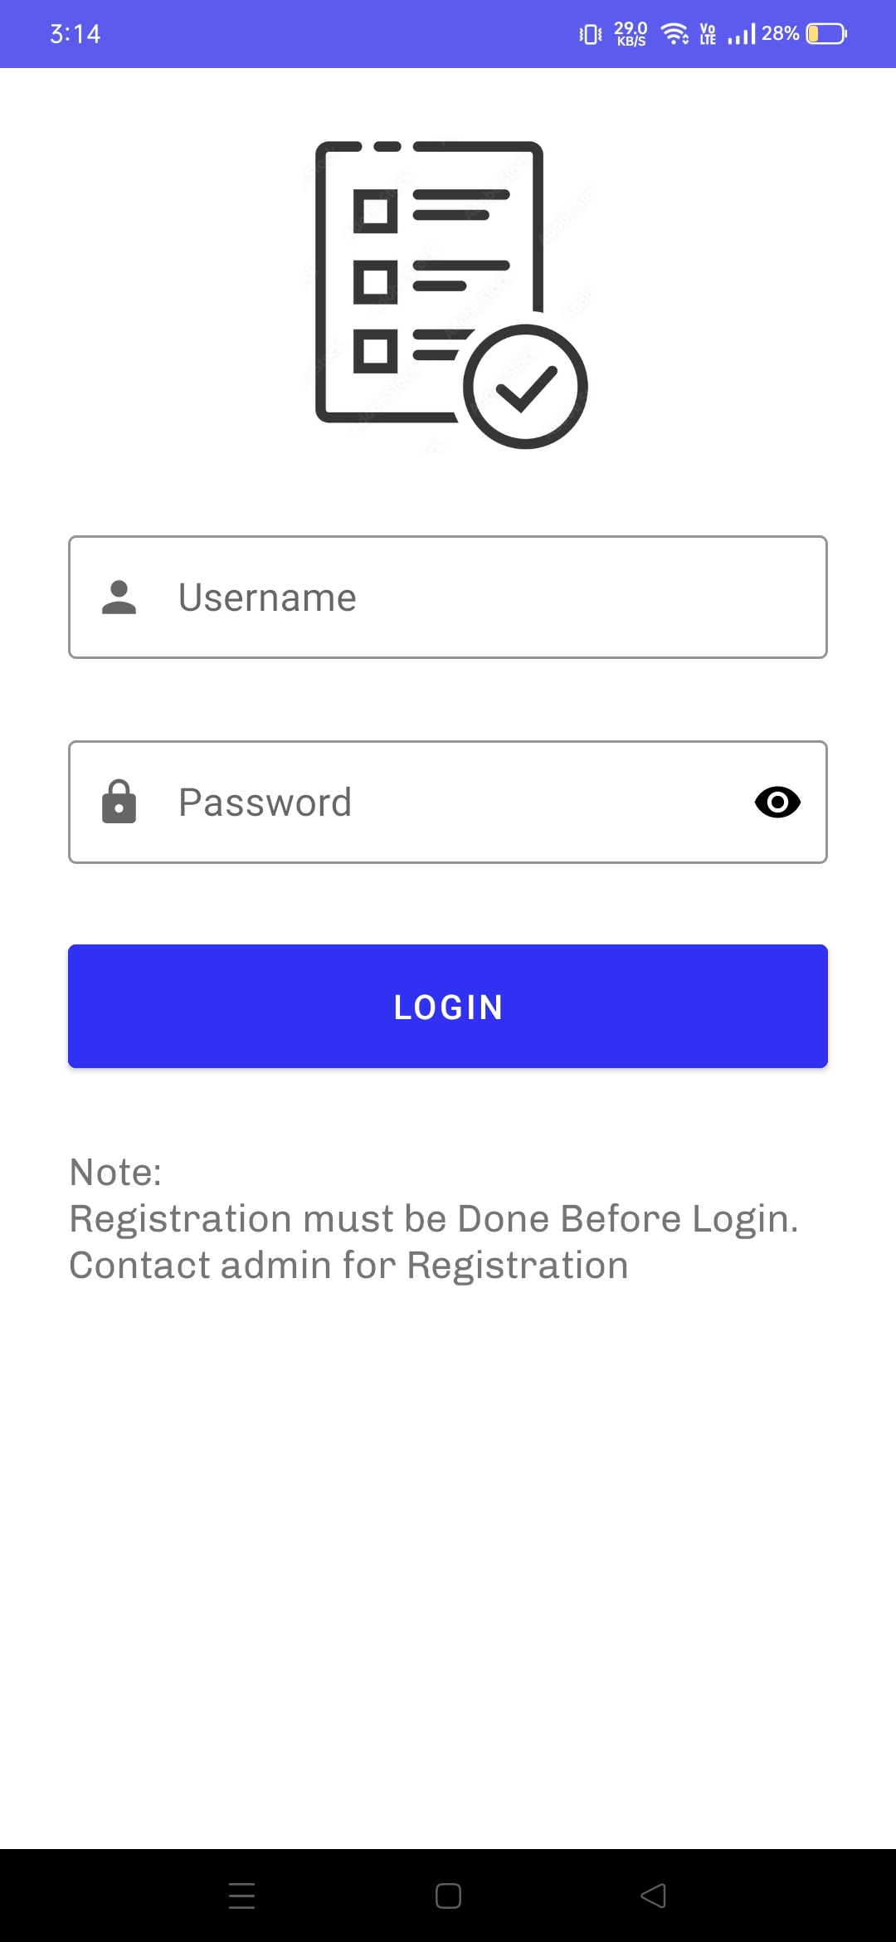

Slide 19
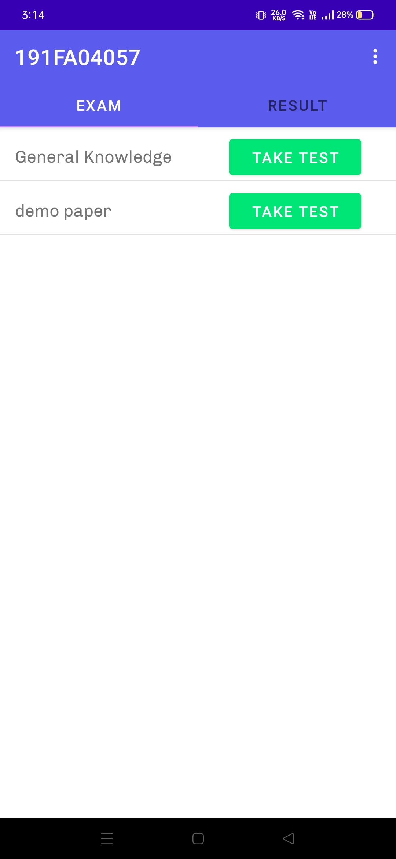

Slide 20
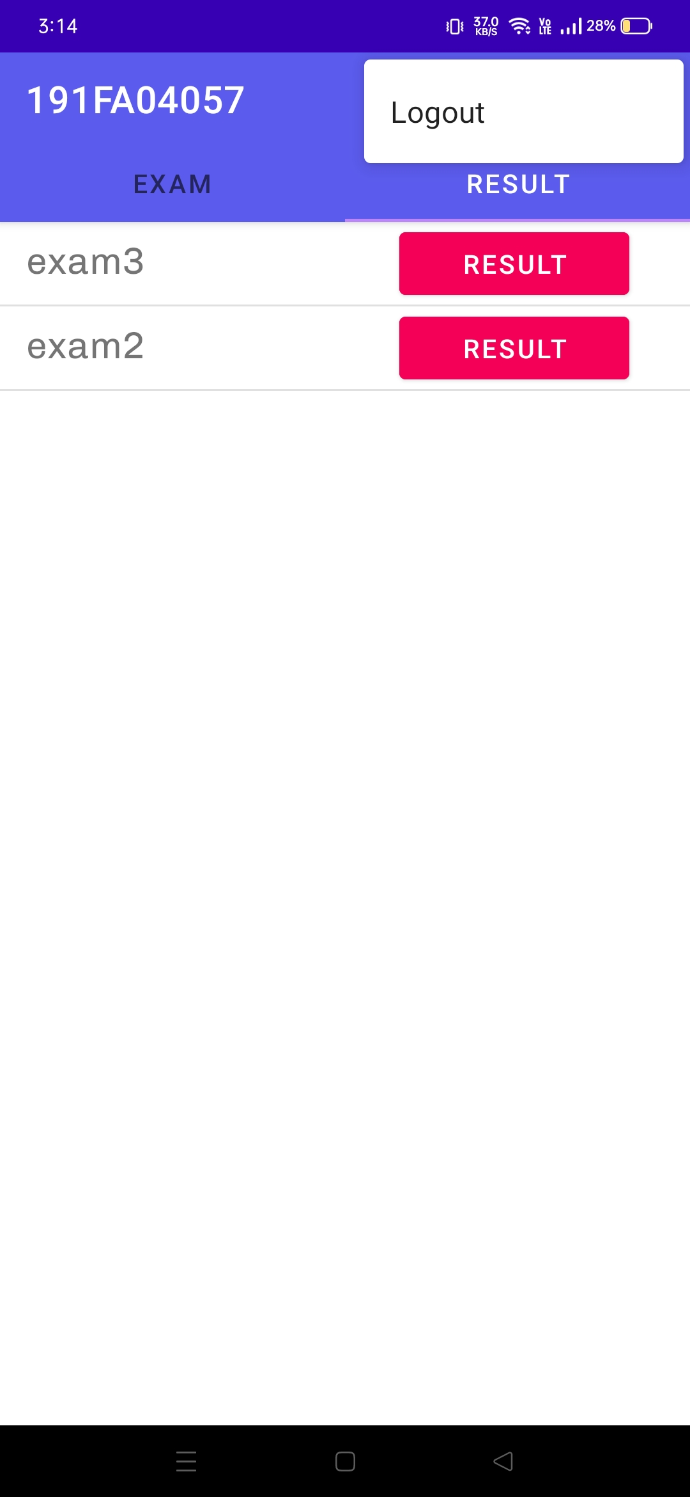

Slide 21
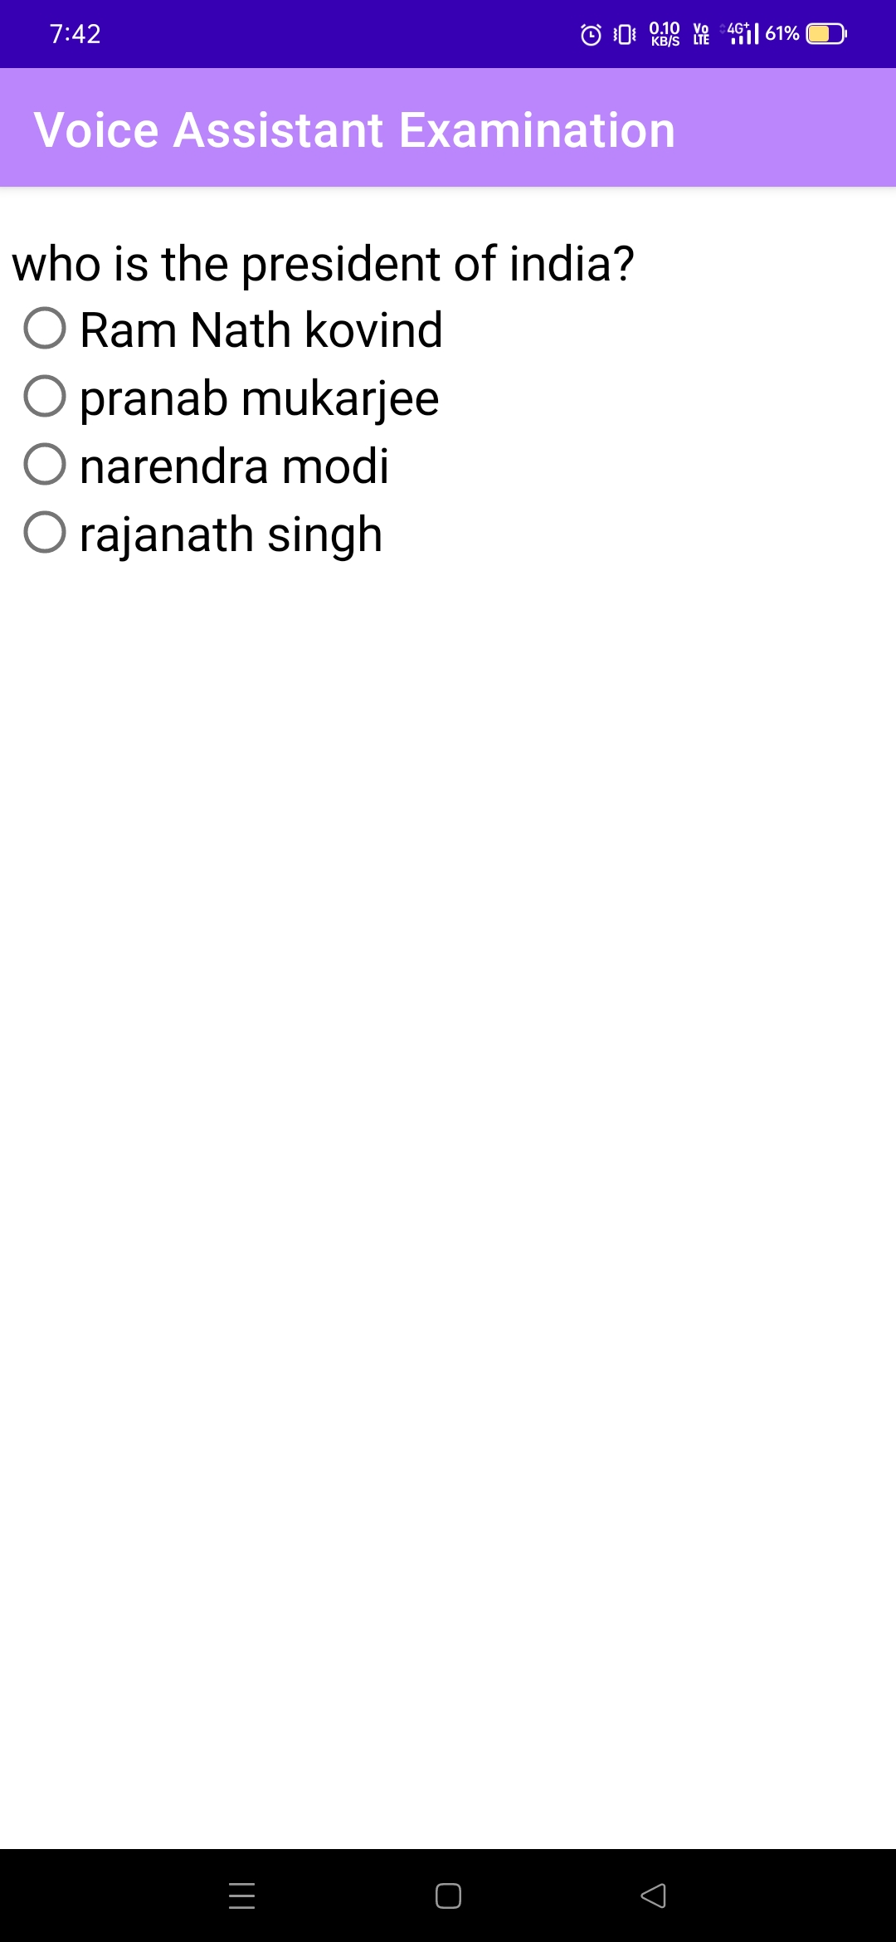

Slide 22
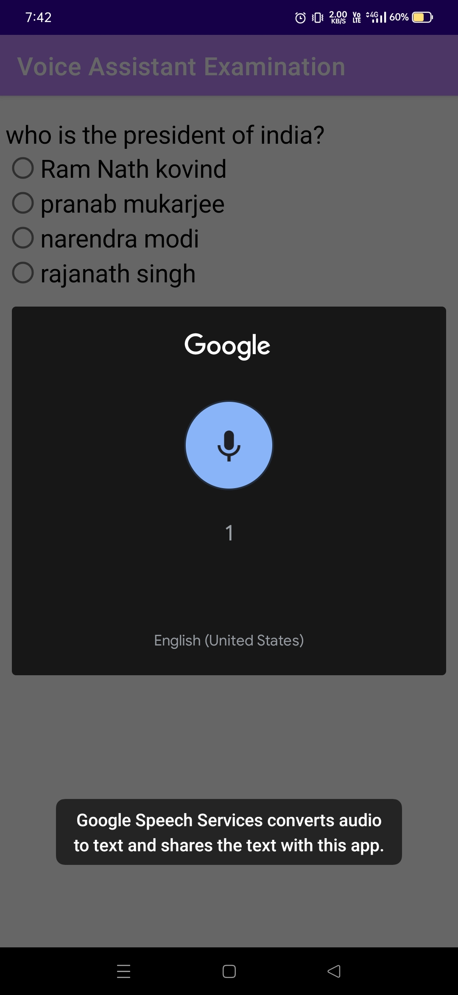

Slide 23
Pros:
Blind Person can able to write the exam without help of other person
through voice
He/She can able to Listen the Question clearly
Voice accuracy is similar to google voice assistant

Slide 24
Cons:
The Accuracy is good only for medium or long words.
If the word length is one or two it might not recognize like if the word
option a it recognize only option not a
The output is unpredictable

Slide 25
Future Updates:
Making Prototype to complete app
Make the app user friendly
Trying to get Accurate Results from speech to text listener
Add statistics and results to the website

Slide 26
conclusion:
Voice assistant examination application will help many of the students to attend their exam independently.

Slide 27


